Slide 1

THEME 2 · PREDICTIVE & FORECASTING ANALYTICS
Predicting Long-Term Health Conditions Across CALD Australians
Population-level prevalence modelling on AIHW 2021 Census data
Syed Haroon Ahmad · Simbarashe Mutyambizi · Md Adnan Abir · Cynthia Ebele Ikegbunam · Najmus Sakeeb (Dan3 Theme2)
PRT661 Data Science Practice · Assessment 3 · Charles Darwin University · Semester 1, 2026

Slide 2

AGENDA
What we will cover
1
Overview, objectives, architecture and workflow
The project today and how the pieces fit together
2
Implementation progress
What is new since Assessment 2
3
Analytics and machine learning
Model selection, errors and the FastAPI service
4
Video Demo
The dashboard, running with the API
5
Technical challenges
What we had to solve to make it work
6
Ethics, privacy and reflection
Responsible use and what we learned
7
Future work before Assessment 4
Deploy, retrain, test and document
2

Slide 3



PROJECT OVERVIEW
From census tables to a working prediction tool
6.6M
16,184
2,717
13
overseas-born Australians covered by the data
published census cells (of 120,978)
population groups: birthplace or language × age × sex
long-term conditions: 10 specific, 3 combined
The question
What the project delivers now
Which cultural, linguistic and demographic factors are linked to long-term health conditions among Australians born overseas, and how common is each condition in a given population group?
Analysis Prevalence by age, sex, birthplace, time in Australia and language
AT Assignment 2
Prediction model XGBoost estimates the % of a group reporting a condition
AT Assignment 2
Unchanged since Assessment 2: we estimate how common a condition is in a group, not a person's risk.
Dashboard + API Findings and predictions in a web app, served by a FastAPI model service
NEW SINCE Assignment 2
Since Assessment 2 the project has moved from analysis and modelling to a working system government bodies can use
3

Slide 4
PROJECT OBJECTIVES
Four objectives, and where each stands now
OBJECTIVE
PROGRESS SINCE ASSESSMENT 2
STATUS
Predict population-level prevalence with machine learning
Chosen at A2 (R² 0.965); now served through the API
1
Done
Dashboard of the key findings from our analysis
Dashboard built and connected to the API
2
Done
Host the dashboard and model on cloud servers
Render blueprint for both services; deploying is next
3
In progress
Document the project from plan to conclusion
Assessments 1–3 delivered; final report is Assessment 4
4
In progress
4

Slide 5

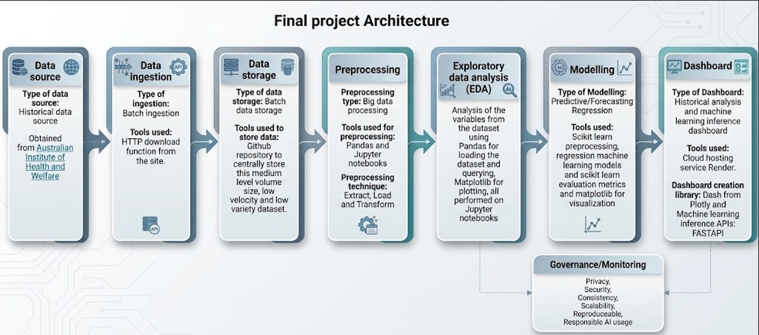
UPDATED SYSTEM ARCHITECTURE
What we added: a serving layer on the pipeline

Slide 6
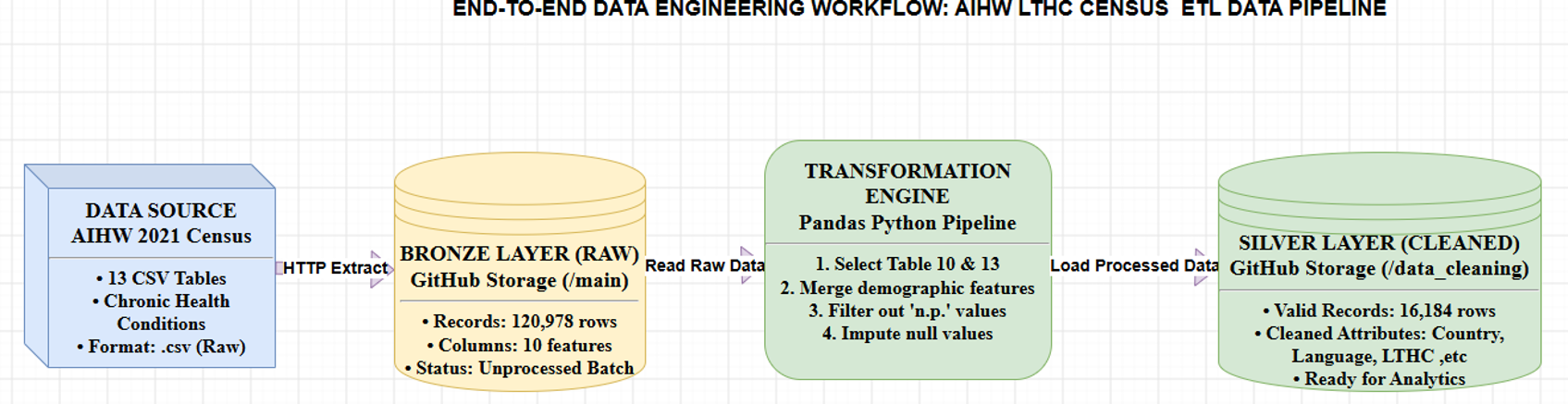
WORKFLOW
From raw census tables to a prediction on screen

Slide 7
IMPLEMENTATION PROGRESS
What we have added since Assessment 2
Area | Now, at Assessment 3
Error and feature analysis | ✓ Errors by prevalence band and the top drivers analysed
Inference API | ✓ FastAPI service: /health, /predict, /predict/batch, validated inputs, tested
Dashboard | ✓ Dashboard: analytics/ model inference
Population-level notice | ✓ Shown on every page and with every prediction
End-to-end testing (M7) | ✓ 47 automated tests: data, model metrics, API and dashboard
All evidence is on the team GitHub in the branches shown, and each item is a task on our Jira sprint board.
7

Slide 8

PROGRESS AGAINST THE PLAN
Milestones: Assessment 2 and now
Week 3
Week 4
Week 5
Week 6
Week 7
Week 8
Week 10
Week 12
M1
M2
M3
M4
M5
M6
M7
M8
Project approved
Dataset collected
Data preprocessing
Baseline model trained
Best model selected
Dashboard prototype
Integrated system tested
Final report submitted
Assessment 2
Assessment 2
Assessment 2
Assessment 2
Assessment 2
Assessment 2
Assessment 2
Assessment 2
Complete
Complete
Complete
Complete
Done early
Not started
Not started
On track
Now
Now
Now
Now
Now
Now
Now
Now
Complete
Complete
Complete
Complete
Complete
Complete
Passes locally
On track (A4)
Two milestones moved since Assessment 2 (red). Still to do: deploy the dashboard and API on Render, then the final report and demonstration for Assessment 4.
PRT661 · Assessment 3 · Group Dan3
8

Slide 9

ANALYTICS AND MACHINE LEARNING
Model selection: XGBoost on groups it never saw
0.965
Test R²
MAE
RMSE
Gap
96.5% of the variation explained
XGBoost
0.965
1.83
2.84
0.019
Random forest
0.964
1.73
2.88
0.022
1.83 pp
average (MAE), in percentage points
Decision tree
0.955
1.89
3.23
0.030
0.019
Linear regression
0.722
5.86
8.03
0.018
train–test R² gap: little overfitting
R² axis from 0.6 to 1.0. MAE and RMSE in percentage points (lower is better). Gap = train R² − test R². Bold: best in column.
Unchanged since Assessment 2: XGBoost has the highest R², the lowest RMSE and the smallest gap of the tree models. Random forest is close, with the lowest MAE (1.73) but a larger gap (0.022).
SELECTED AT A2
9

Slide 10
ANALYTICS AND MACHINE LEARNING
What drives predictions, and where it misses
Top XGBoost features (% of importance)
Average error by prevalence of the cell
53% of importance comes from two inputs: 'one or more conditions' and age 65+. The decision tree and random forest rank the same two first.
PRT661 · Assessment 3 · Group Dan3
10

Slide 11
Video Demo
Notes:
]

Slide 12



TECHNICAL CHALLENGES
What we had to solve to make it work
Model tied to library versions
Data-quality issue found
Dense dashboard for small screens
The preprocessor only loads with the scikit-learn version it was pickled with.
AI-assisted language–country pairings, e.g. China → Uygur.
Chart original appeared cramped on small screens
→ Pinned every version; tests load the saved model.
→ Flagged in the dashboard; fix the mapping and retrain before A4.
→ Dashboard now scales with device screen size
PRT661 · Assessment 3 · Group Dan3
15

Slide 13


ETHICS, PRIVACY AND SECURITY
Responsible by design: what the system enforces
Ethics
Privacy
Security
Population-level notice on every page and every prediction
Only de-identified, aggregated AIHW counts
No passwords or keys in the repository
Users can see the model input, the drivers and the limitations
The dashboard stores nothing a user enters
AI-assisted language mapping disclosed and flagged
Never goes below the level AIHW publishes
Built into the system since Assessment 2
In place at Assessment 2
Estimates describe groups, to support planning. They are never an individual diagnosis.
16

Slide 14






REFLECTION AND FUTURE SCOPE
What we learned, and where this could go
What we learned
Future scope, beyond this unit
1
Understand the data before modelling
Seeing that rows are groups, not people, shaped every later decision.
Rerun on the 2026 Census
when AIHW publishes it; the pipeline is designed to repeat
2
Library version control
Ensure consistant library version across parts
Uncertainty and explanations
a range and the main drivers for every prediction
Trends over time
compare census years, not just 2021
3​
A working demo changes the conversation
The dashboard turns analysis into something people can use.
Co-design with users
health agencies and community organisations
17

Slide 15

WHAT HAPPENS NEXT
Future work before Assessment 4
# | Task | Outcome | Lead
1 | Deploy both services on Render and share the link | A live dashboard and API anyone can open | Simba
2 | Usability testing of the dashboard | Feedback from real users, and fixes | Cynthia, Adnan
3 | Scripted pipeline from download to deployment | One command reruns everything | Simba
4 | Keep Jira and the risk register current | Governance evidence for the final report | Najmus, Haroon
5 | Final report and final demonstration | Assessment 4 submission | Everyone
Goal for Assessment 4: a deployed, reproducible system with a retrained model and complete documentation.
18

Slide 16

Thank you
Questions welcome: on the model, the API or the dashboard.

